Slide 1
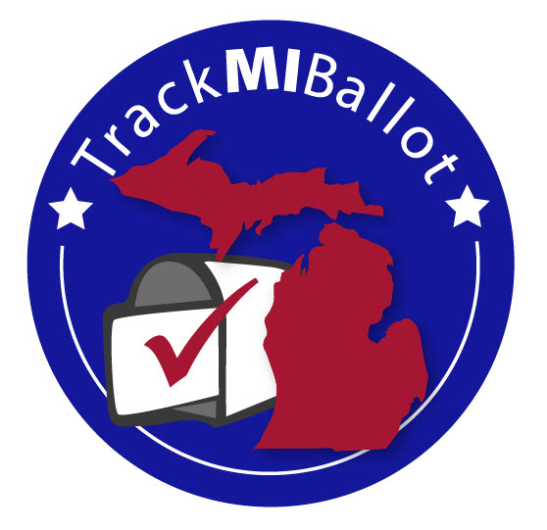




A revolutionary tool to track every mailed ballot from Clerk to voter and back again.
Powered by
In a partnership with

Slide 2
KCI Already mails ballots
KCI picks up mail daily from 14 units across west and central Michigan

Slide 3

TrackMIBallot
KCI is launching a service that integrates real time information from the USPS to follow mail creating a secure, easy to use system to track your outbound and inbound election mail similar to the way FedEx and UPS track packages
We call it:
This new service will be operational in early June 2020 and will be available for use in the August Primary

Slide 4
Two of the immediate challenges facing election officials are:
Secure and accurate election results
Ballot Security and the huge increase in AV ballots that will need to be mailed out and recorded
Michigan in an effort to help, has enacted “no excuse” absentee ballot voting
The pandemic has made going to the polls a potentially hazardous trip

Slide 5
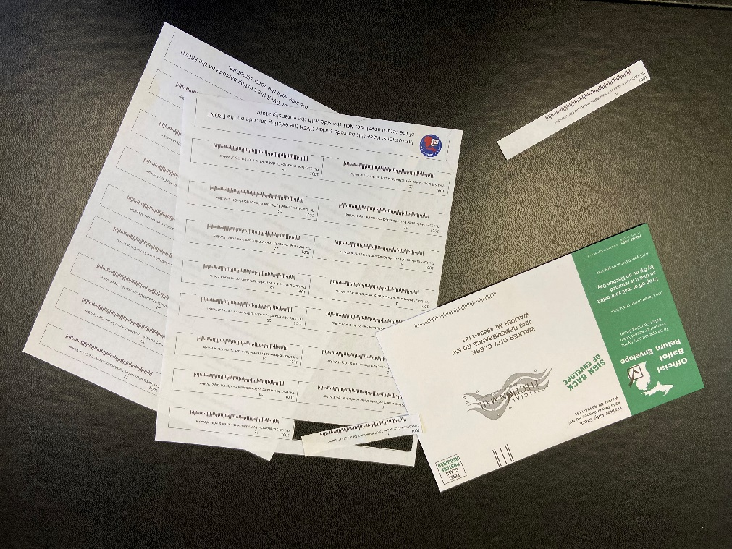
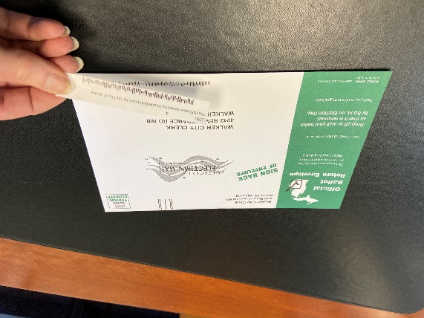
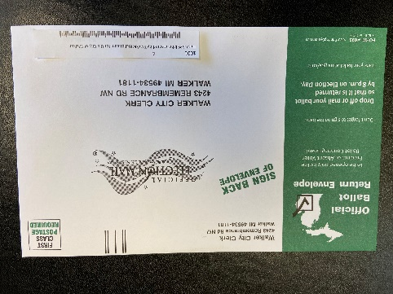
How it works:
KCI supplies a unique tracking barcode label for each precinct and ballot number
Prior to mailing, election workers label over USPS barcode on return envelope with tracking label

Slide 6
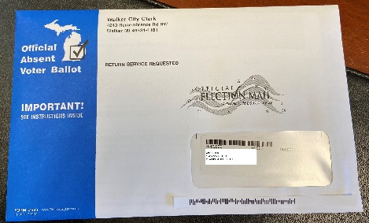
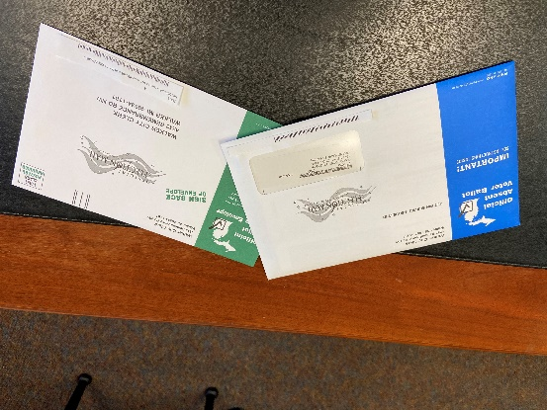
Next Step:
Election workers insert ballot, security sleeve, instructions and return envelope (with new barcode) applying mailing label generated from QVF file
Unit (or KCI) meters at nonprofit $0.184
KCI sorts outgoing ballot on MLOCR
UPS / FedEx style tracking available on TrackMIBallot website

Slide 7
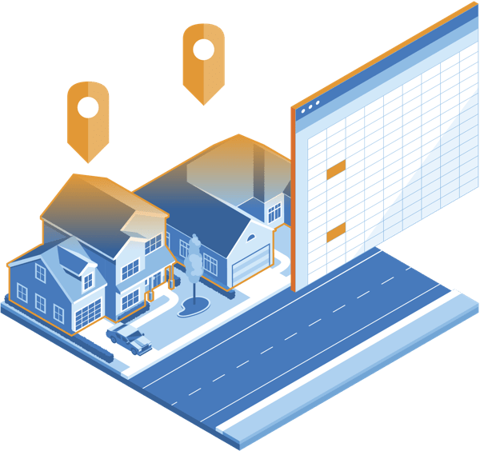
We developed TrackMIBallot by understanding how Clerks in Michigan process absent voter ballots and creating a solution that works within the current system
We know that we can use the USPS barcoding system and the new IV (Informed Visibility) tracking to track a piece of mail through each and every scan point in the USPS system
Most mail routes are GeoCoded by the USPS so they can track a properly barcoded piece of mail down to the logical delivery time.
UPS / FedEx style tracking
Not just priority and express mail
ANY mail. Including YOUR election mail

Slide 8
With IV, you can track the election mail from when it left your office all the way to when it gets returned to you. Like FedEx and UPS
With the USPS
It is secure and safe
It is cost effective. The postage savings cover the cost of the service. It winds up essentially being free
It is simple to set up
It is simple to use
Clerks have a couple minor process changes and then they are up and running!

Slide 9
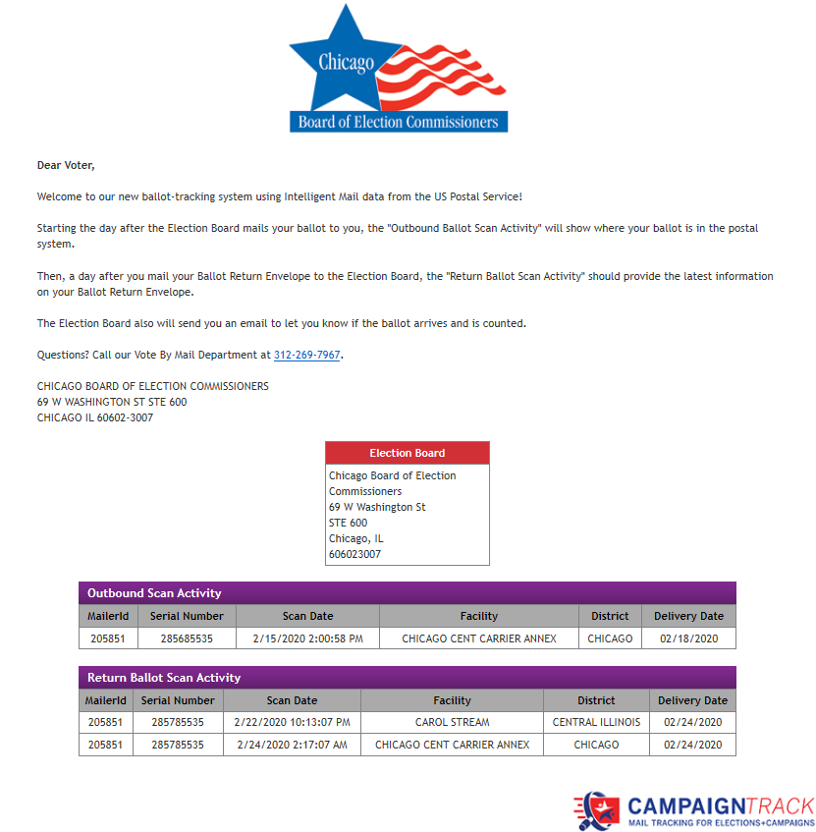
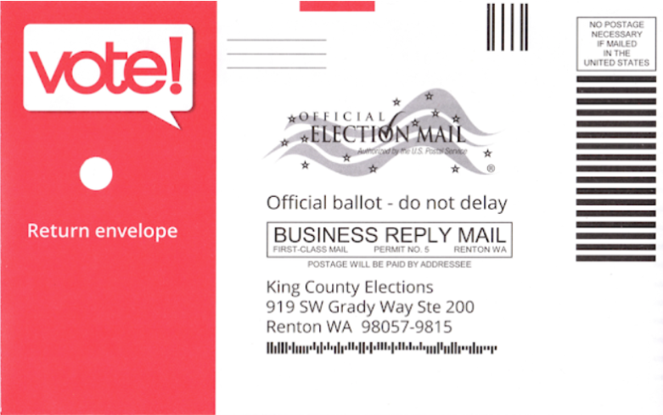
Absentee and Vote-By-Mail Ballot Tracking
Informed Visibility allows you to track and confirm the mailing of ballots to the voter, and to follow the ballot in after it’s been mailed back
Many states have begun requiring voting authorities to share this data with voters

Slide 10
“The USPS is generating the data, we just have to figure out how to wrap our arms around it.”
KCI is partnering with SnailWorks who specialized in taking the massive amounts of information the USPS generates and putting it into usable formats to allow us to use the tracking data
KCI also engaged a few of the clerks we have great relationships with and asked for input on how to best present the data
We came up with TrackMIBallot

Slide 11
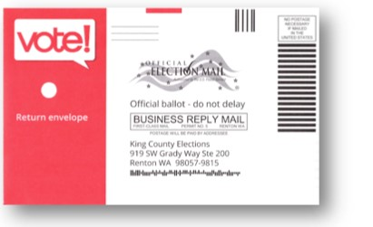
To understand how TrackMIBallot Works, you first need to understand what an IMB (Intelligent Mail Barcode) is
This is where the IMB is
The Intelligent Mail barcode (IMb) is a 65-bar Postal Service™ barcode that is used to sort and track letters and flats. It allows mailers to use a single barcode to:
Specify the type of mail (election, media, etc.)
Who the mailed the piece (Mailer ID number)
A serial number that is unique and specific to that individual piece of mail.
The delivery address – essentially a 6-digit ZIP

Slide 12
“That is a lot of information in a small area. “
It is a lot of information.
The USPS and KCI have been using these barcodes for over a decade
Election mail has its own specific code
Over the last several years, the USPS has been developing a system to mine the data as it is going through the postal stream
They can (and do) track each of the billions of pieces of mail it processes every day. This is called Informed Visibility Mail Tracking and Reporting (IV-MTR)
It also creates a lot of data. In reality, so much data that organizations have difficulty making sense of it.

Slide 13
The rules about ballot handling are very specific. How can you do this?
Yes, the rules are VERY specific.
Voter ID and Ballot numbers are not tied together until the Clerk assigns the ballot to the voter ID. And the ballot number and voter ID MUST be on the return envelope that comes back.
This created a challenge. Unless you knew ahead of time your ballot numbers and ordered your envelopes with the barcode that had the precinct ID, Ballot ID and Mailer ID on it, the IV-MID wouldn’t work.
KCI has a solution for that.

Slide 14
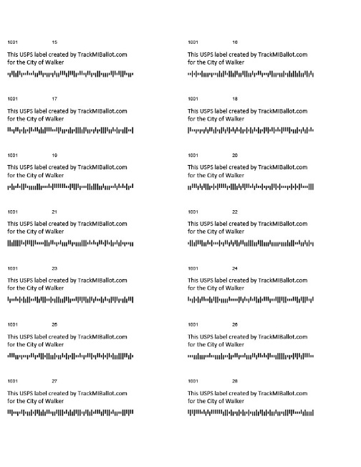
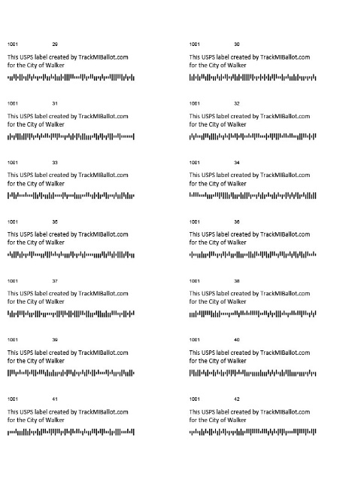
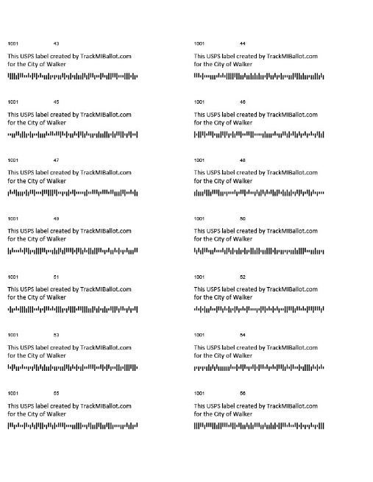
Labels
Units will provide KCI with and excel spread sheet that contains the ballot numbering range and the precincts they belong to
The Clerk will request the number of pieces that want barcodes for:
KCI will print a tracking barcoded label.
  The label will include a message about mail tracking, ward/precinct number, ballot number and trackable USPS barcode
Send the requested number of labels in sequential order to the clerks
When the election worker prepares the ballot for mailing
  They will select the label that corresponds with the precinct and ballot number
  Apply the new barcode over the existing barcode on the ballot return envelope
  The prepared ballots must be sent through KCI for mailing
  When KCI applies the outbound TrackMIBallot barcode, we read the voter ID barcode and tie them together
  The Clerk can then track that particular ballot in transit both ways!
  The clerk will need to destroy any unused labels after the election day

Slide 15
What happens next?
With the file, the clerk can see where In the mail stream the ballot is. When a voter calls and says, “Where is my ballot?” You can pull look up via the voter ID and it will tell you where in the mail stream the ballot is.

Slide 16
How it works
After the Clerks office has prepared the ballots and applied the TrackMIBallot barcode to the return envelop. Units who use our service will:
Deliver or have KCI pick up ballots on a pre-arranged schedule
The SAME DAY KCI received the ballots, we will barcode, sort and deliver to the USPS
The ballots are NOT stored at KCI. They move from the truck to the sorter
KCI uses a USPS approved postal sort and barcode machine that will:
  Read the voter ID (from the address block that the clerk used).
  Record the USPS barcode
  Tie the USPS barcode to the Voter ID #
  Encrypt The data.
  Send the file to SnailWorks

Slide 17
Can you track the ballots being returned?
Yes. You can track the ballot on its way back too
You can track the ballot on its way back to you
This is different from the SOS system. The SOS system just records that the ballot was mailed. It does not track where it is OR when it arrives
TrackMIBallot is setup with a “Parent / Child” relationship to allow county Clerks to track mail for all their units

Slide 18
TrackMIBallot vs. current method
Conventional
TrackMIBallot
Clerk Pays .65 for postage
Mails ballots out
Hopes it get there
Voter sends back
When received, Clerk records
If delayed, no information on where in the system the ballot is
Clerk sends ballots to KCI
Postage is .184 ea.
Voter receives
Clerk can check to see when/if placed in voters mailbox
Voter sends back
If delayed, Clerk can see where in the postal stream the ballot is

Slide 19
Email Notification
When application mailed email will be sent to the email address on the QVF file
Email contains a link so voter can watch scans as ballot goes out and is returned
Cost around 3 cents per voter
Beta version for the August primary
If SOS would agree to post TrackMIBallot tracking links on SOS website we would make all email programs part of the base service offering

Slide 20
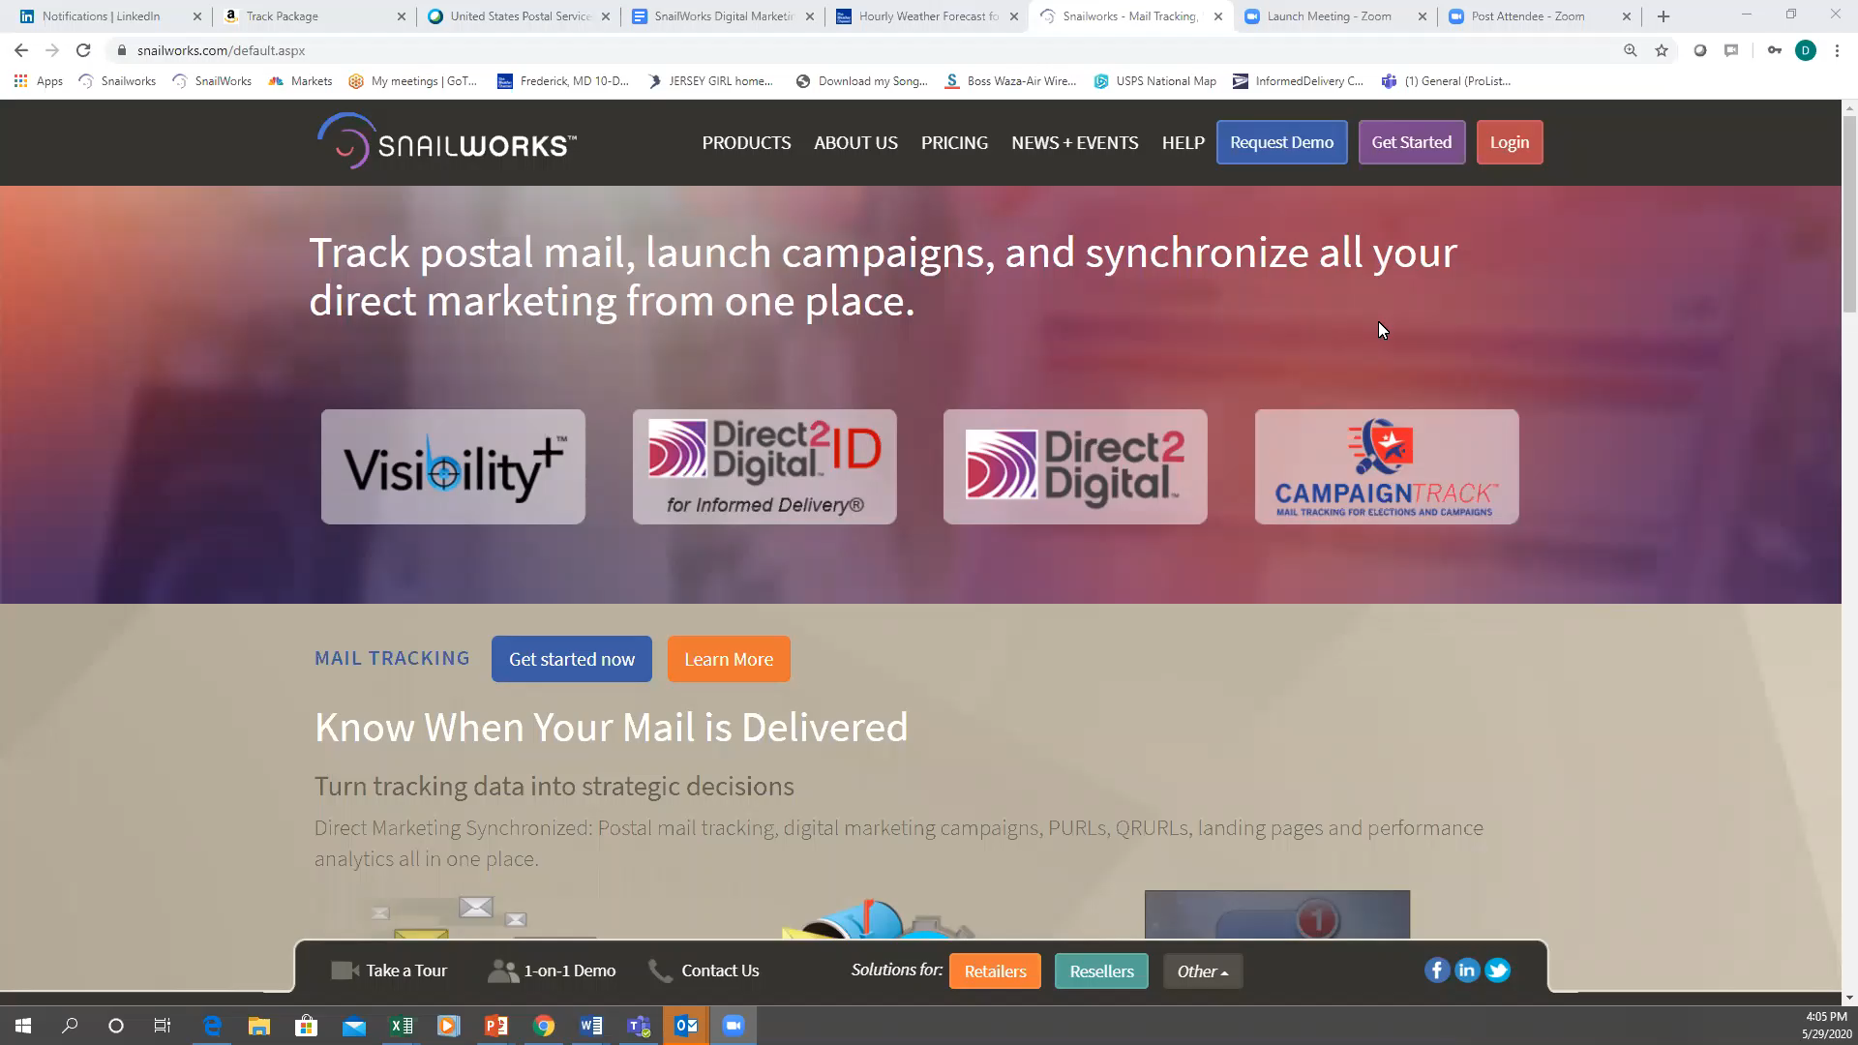
Video Demo

Slide 21

Video Demo

Slide 22
TrackMIBallot will require very few changes for Michigan Clerks
The difference in the postage rate will pay for all the services of TrackMIBallot

Slide 23
Questions for us?

Slide 24
Questions for you?
What does not work?
What interests you the most?
How do we get a wider audience?
Any chance we could get a data file to setup all Clerks in MI at the same time?

Slide 25
What next?
Every unit needs to apply for nonprofit mailing status
Visit: kentcommunications.com/clerk-resources/

